Slide 1

Lesson: 1.2
Creating Complex Objects

Slide 2
Lesson Objectives
You should be able to...
1. | Create empty game objects
2. | Group objects together using Parent / Child relationships
3. | Build complex game character
4. | Preview a live version of their game.
5. | Create a physic material with a bounce effect.
6. | Add Colliders to see objects interact with each other.

Slide 3
Key Terms
Empty Game Object | A starting point for building and organizing Game Objects in the Hierarchy panel. It contains no existing models or elements.
Parent/Child relationship | A method of grouping objects together in the Hierarchy Panel to build complex objects from multiple sources.
Rigidbody | A component that when added to a Game Object, tells Unity that the object should be affected by Unity's built-in physics engine.
Physic Material | A component that affects the physical characteristic of a Game Object
Collider | Defines the shape of a game object for the purpose of physical collisions.

Slide 4
Hook - 1
Favorite Characters

Slide 5
Favorite Characters?
What is your favorite game character? (Round table this question with your team)
Master Chief?
Mario and Luigi?
Lara Croft?
None of these characters are primitive forms. They are complex, detailed, and masterfully developed. Unity itself is not a 3D modeling platform. Most characters are built in 3D modeling programs such as Blender, 3DS Max, or Maya then imported for use in Unity. Unity is where these models become animated, programmable and provided Artificial Intelligence or given controls for you to play as them.
But that doesn’t mean we can’t build simplified complex forms with Unity. In this unit you will learn how to build more complex shapes and designs to make your 3D environment more usable and begin building your first game character!

Slide 6
Instruct
Building More Complex Objects

Slide 7
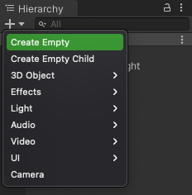
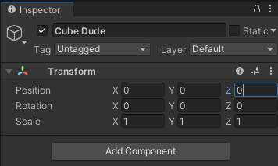
Empty Game Objects
Creating Empty Game Objects allows us to build complex objects.
Starting with an Empty Object is a good method because it sets default attributes to the object.
In the Hierarchy Panel Click the “+” button and select Create Empty
Rename this Object “Cube Dude”, or any other friendly name.
Zero out the transformation so the object origin is at 0,0,0.
1
2
3

Slide 8
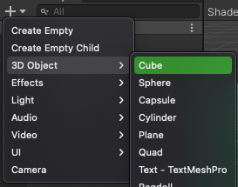
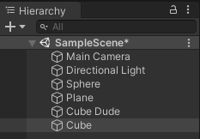
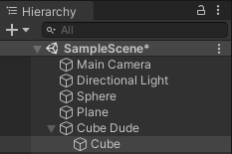
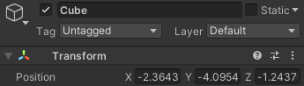
Parents & Children - 1
Create a new Cube object in using the “+” button
*Note the Position of this Cube in the Inspector
Select the Cube Object, then drag it onto the Empty “Cube Dude” Object
This Creates a Parent /Child Relationship where “Cube” is an object within “Cube Dude”
1
2
3
“Cube Dude” is still at position 0,0,0 but “Cube” maintains its position attributes relative to the “Cube Dude” object. Changing the position of the parent object will now move the cube visually, but not change its position attributes in the inspector.

Slide 9
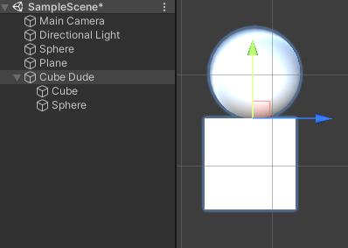
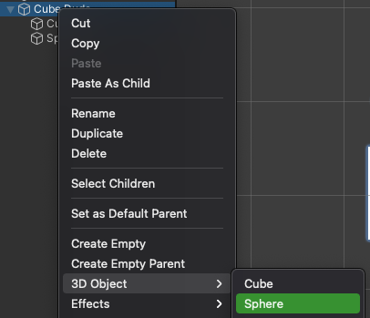
Parents & Children - 2
You can add more objects through the drag and drop method, or right click on the parent object and select objects to automatically add them as children.
Add a Sphere as a child to the Cube Dude Object. Position this on top of the cube to act as the head of a character.
*Remember that each child will have it’s own attributes but the Transform properties will be relative to the properties of the parent object.

Slide 10
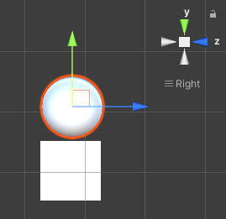
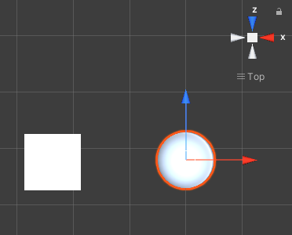
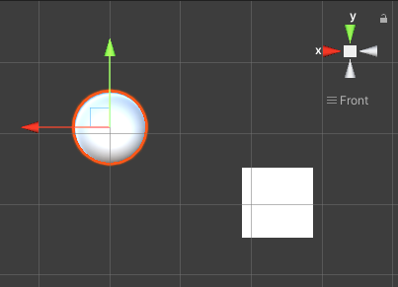
Parents & Children - 1
Positioning Objects together
It is critical that you view new objects from multiple angles to ensure they align as expected. Newly placed objects may appear correct from one angle, but when viewed from another angle it will show as not aligned as expected. Always view and align objects from each axis before moving on.
Viewed from the X-Axis, the sphere appears on top of the cube.
Viewed from the Y-Axis, the sphere is obviously not on top of the cube and needs adjustment.
Viewed from the Z-Axis, the sphere needs further alignment

Slide 11

SAVE YOUR WORK!!!

Slide 12
Hook - 2
Get Excited!

Slide 13
Explosions!
Physics and movement
Tired of living in a world where nothing moves? Wondering when gravity will make all these objects fall to the ground? Hoping they bounce around a bit?
This is the chapter that shows you how to add physics to your objects. You will preview your game for the first time and use gravity and physical collisions to make your object interact with each other. Get ready to see something explode for the first time!

Slide 14
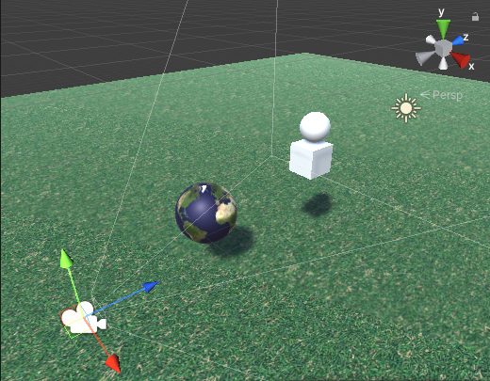
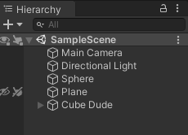
Previewing the Game
Up to this point you have only been adding objects to the scene view without seeing how their game is actually played. Previewing a game allows you to incorporate the time factor and see how the mechanics of the game works, all from the camera perspective.
All games should have a Main Camera. This provides the view from the player’s perspective. By default there is also a Directional Light to provide lighting to the scene.
Directional Light Icon
Main Camera Icon
*Note: If the camera or light icon is not visible in the scene, activate the gizmos in the upper left area of the scene view.

Slide 15

Previewing the Game
To preview the game press the play button in the top center of the Unity workspace.
Play/Stop: Press once to start the game preview. Press again to stop the preview
Pause: Press once to Pause the game without restarting.
Step: Used for debug scripts by stepping through script lines.

Slide 16
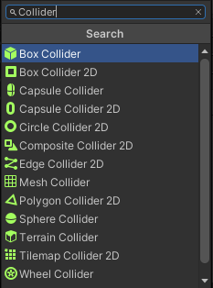
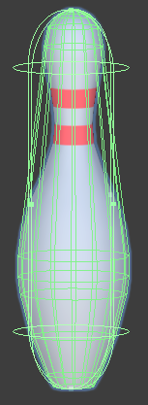
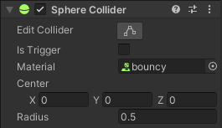
Colliders
The Collider Component defines shape of your game object for the purpose of collisions. These can be simple shapes (usually a box, sphere or a capsule). Or they can be complex shapes like the actual shape of your character.
If your Game Object does not have a collider you can add one by pressing “Add Component” in the inspector and searching for “Collider”
You can also edit the shape of you collider here:
Adjusting the shape of your colliders provides the ability more precisely where an object should collider with another object.
Collider shapes are shown as green outlines

Slide 17
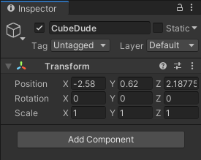
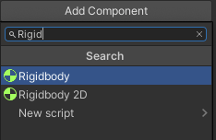
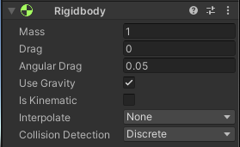
Rigidbodies - 1
Rigidbodies allow our Game Objects to have solid physical boundaries. With Rigid Bodies our Game Objects cannot share the same space and therefore bounce off or collide with each other if the come into contact with each other.
To add a Rigid Body: Select CubeDude (or any Game Object). In the Inspector, click Add Component at the bottom. Start typing in Rigidbody to the search box until it appears and click on it.
1
2
Rigid Body Options will now appear in the Inspector Panel
3

Slide 18
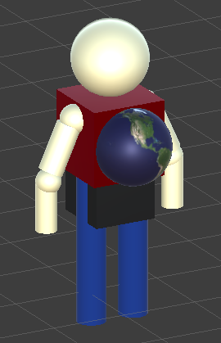
Rigidbodies - Try It!
In the Scene View, place two separate game objects together so they overlap. Add the Rigidbody Component to each game object, then press the play button. What happens?

Slide 19
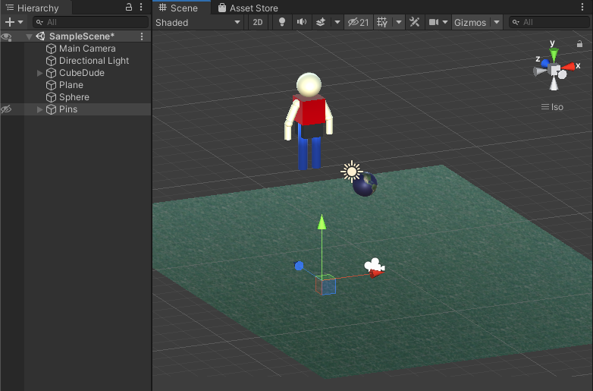
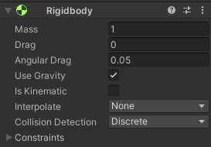
Rigidbodies - Using Gravity
The Rigid Body Component has a Gravity option. This forces the game object to fall downward. Let’s experiment with this too!
Enable Gravity for your Cube Man or other Game Objects (not on the plane)
2
Press play and watch!
3
Place a Plane object below your other game objects
1

Slide 20
Explore
Team Discussion

Slide 21
Discussion Time
Talk about your observations with your team. Some experiments may result in minimal movement between objects while others may be quite explosive. You will also get some of the characters landing onto the plane and staying upright, while others will fall over and even off the edge of the screen.
Why is this?
What could be affecting the interaction between these objects?
How do you make the collisions more explosive?
How can you get the Cube Dude to land on the plane but not tip over?

Slide 22
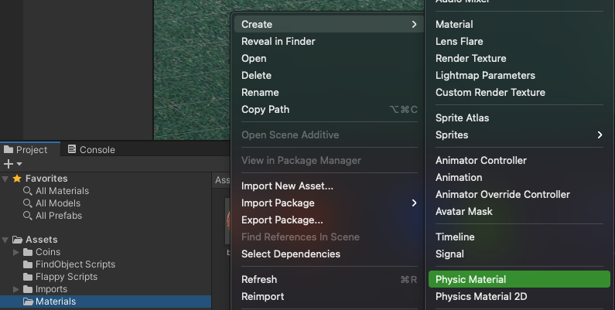
Physics Materials - 1
We can also add other physical attributes to objects. Like Bounce...
In the Project Files navigate to the Materials Folder, right click and Create -> Physics Material.

Slide 23

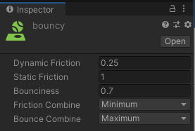
Physics Materials - 2
Name this Material “Bouncy”
In the Inspector Panel, change the Bounciness value between 0 and 1.
Change the Bounce Combine to Maximum

Slide 24
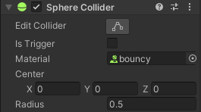
Physics Materials - 3
Create a sphere object, or select any other Game object.
In the Inspector find the Sphere Collider or Box Collider (depending on which object you are applying this to)
Find the Material property in the Collider options and click the circle to select your physic material. (Or you can drag the physic material from the Project files into this box.)
Press Play to see the affect!
Experiment by changes the values of the bouncy material. Can you make it bounce more? Or less?

Slide 25
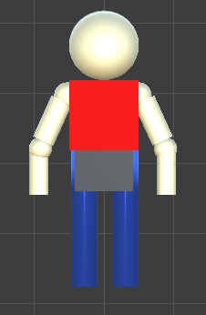
Your Task
Create a character using basic primitives that are grouped as a single object with the parent-child relationship.
Utilize different materials to provide color and texture to the different elements of your character.
Be creative! Add extra arms or legs! Maybe create something entirely different.

Slide 26
Share and Reflect
Your Characters

Slide 27
Show It Off!
Show off your character! Share your screen with your team to show what you have created.
Make to view your character from many different angles to see if there are alignment or positioning issues.
Do you think Unity is the right tool for character development is there a way to create more detailed objects in Unity, or do they know of other methods?

Slide 28
Key Terms - Review
It’s important to review key terms from the lesson.
Try and define what these terms mean and describe how you used them in your game!
Empty Game Object
Parent/Child relationship
Rigidbody
Physic Material
Collider

Slide 29
Extension
Done Early?

Slide 30
Your Task
Use the Sphere primitive to create a bowling ball and a basketball, using both physics and renderer materials to sell the effect.
Drop the ball onto other objects using a collider to initiate over physical movements
🏀 🎳

Slide 31
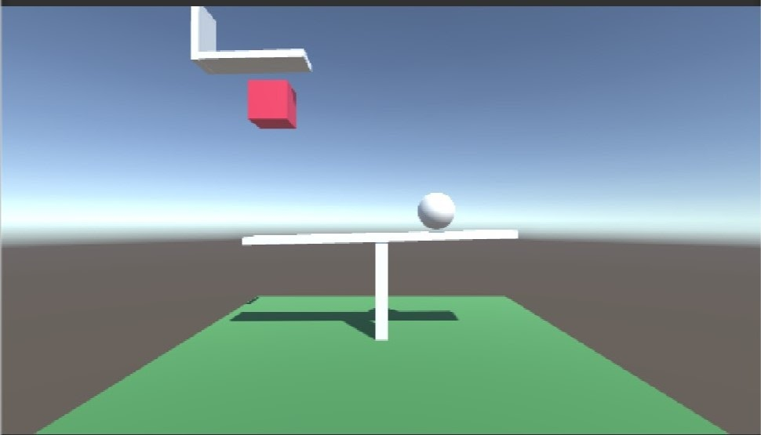
Two Options
Angry Bird Style Game - Try to setup a scene where an object is “shot” toward a cluster of other objects and knocks them all down.
Advanced - Challenge yourself by creating a Rube Goldberg machine using only primitive shapes and rigidbodies. You can Google “ Rube Goldberg machine” to get some inspiration.

Slide 32
Extend your ideas
Substructures: You can have layers of objects within each game object. There could be a whole group for an arm, or leg within the parent character object. Challenge yourself to build a character in a more organized and easier to manipulate manner. Duplicating substructures is also a good way to make even more complex characters quickly.
Naming Conventions: You should also name each object accordingly to make it easier to navigate and identify in the hierarchy.

